Slide 1
Creative Brains: Rhetorical Approaches to Neuroscience
Jordynn Jack
University of North Carolina, Chapel Hill
@jordynnjack

Slide 2
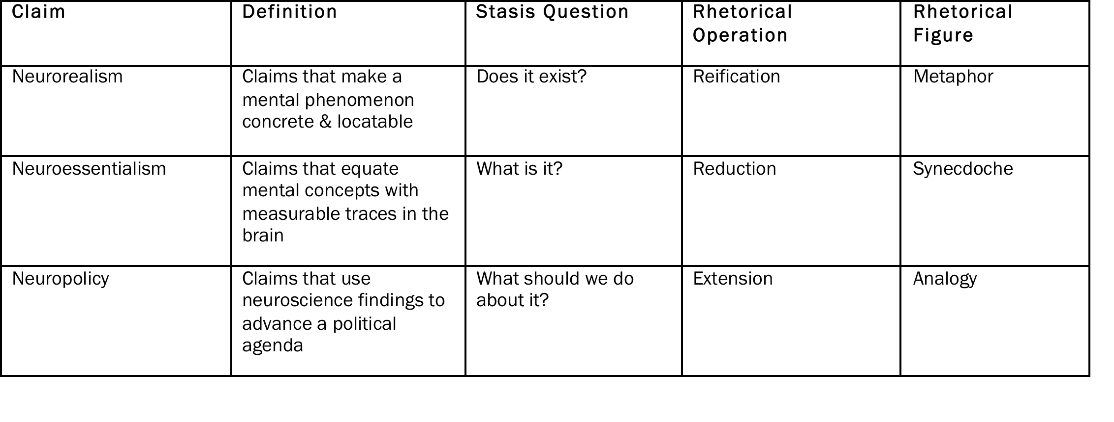
Neuroclaims and Stasis Theory

Slide 3
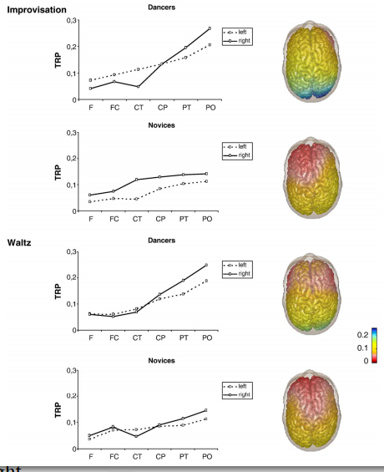
The Case of the Modern Dancers

Slide 4
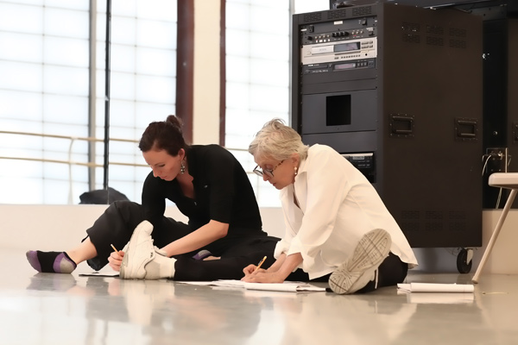
Creativity in Dance

Slide 5
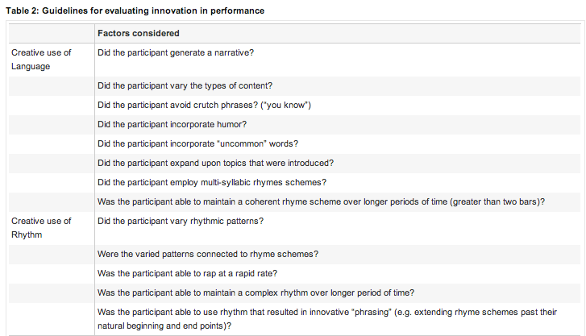
The Case of the Freestyling Rappers

Slide 6
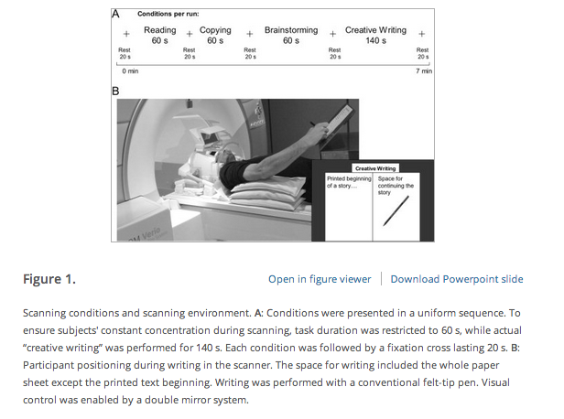
The Case of the Creative Writers

